Slide 1
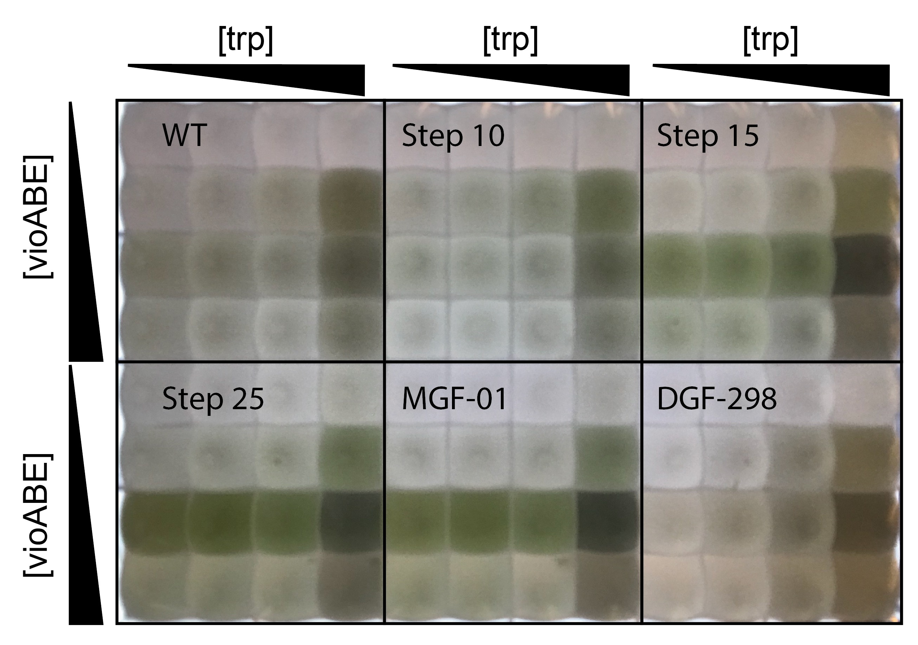
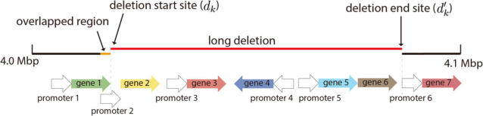

Optimal Protein Reclamation with MaxMass
Jeremy Zucker, Neeraj Kumar, Jeremy Teuton
File Name // File Date // PNNL-SA-#####
Notes:
NOTE: Print this poster file at 200% SCALE to result in a physical print measuring 72” wide x 48” tall. All type size notations shown above are based on the final printed size of the poster.
• Contact Digital Duplicating (375-2969, http://digitalduplicating.pnl.gov) to order poster printing and finishing services for your completed poster design.
• Remember to have your poster cleared for public display/distribution through the Information Release system (http://informationrelease.pnl.gov).
• Sidebar “About PNNL” box is considered optional, and can be removed if space is needed for technical content.

